Slide 1


CSE 445/598
Distributed Software Development
Chapter 3
Essentials in Service-Oriented Software Development
Lecture 11
Service Deployment, Hosting, and Registration
Reading: Text Chapter 3

Slide 2
Roadmap Chapter 3
Overview of SOA Development Platforms
Basic .Net Web Services and Applications
service development (provider)
service hosting and deployment (provider)
service publication and registration (broker)
application building (client)
Examples
Java-based Development
L10
L11
L12
L13

Slide 3
Service Hosting and Deplaoyment
Service brokers
Registry
Repository
Hosting
Application builder
Service providers
Application
Service
Hosting

Slide 4
Different Ways of Hosting Your Services
Internet Connection
.Net
Development / IIS Express Server
IIS
on
Windows
Web Server
with IIS or
Tomcat
Self
hosting
Professional
Service
Providers
Running
services
as threads
Text chapter 7
Localhost in. Net
Environment
Low volume
services

Slide 5
Service Hosting by Internet Information Services (IIS)
IIS are services running on Windows servers, as well as on local Windows.
IIS are
running all the time, listening to the requests, and queuing the requests;
redirecting requests from remote clients, who want to access a particular service (incl. application) on the server, to the right service hosted on IIS;
managing resources sharing among services on IIS;
authenticating remote callers and safeguard data
supporting Secure Sockets Layer (SSL) connection.

Slide 6
IIS Server and Service Adminstration
Application/
Service
Registration
Browser
Browser
Browser
Browser
IIS Web Server
http and other requests
http.sys
Listeners and router
Web Administration Service (WAS)
Buffer Queue
Kernel mode, is isolated from user code crash
Application Request Queue
Service Request Queue
lookup
…
Registry
Metabase
User mode
Register by converting to application; Add to DB
IIS worker process (w3wp.exe)
IIS worker process (w3wp.exe)
threads
Service code is running as a thread in the worker process
Add to an existing queue or create a new queue
Application code running as a thread in the worker process
Service code is running as a thread in the worker process
Application code running as a thread in the worker process
…

Slide 7
Example: IIS Request Processing
Inetinfo
WAS Service
Data & Services
Web Administration
&
Monitoring
FTP
XML
Metabase
NNTP
SMTP
…
User mode
Kernel mode
Queue
Cache
IIS
HTTP
Request data
Service with
Input and output

Slide 8
Deployment with Just-In-Time Compilation
Deploy uncompiled source files (C# code): Simply copy the entire project folder into the server
The code will be compiled & stored at the 1st request;
It is slow for the first request (cold start);
Code visible for anyone who has the admin login to the server, e.g., group members of WebStrar;
If the source code is modified or replaced, the code will be recompiled at the next request;
It is flexible and supports dynamic re-deployment of the program without stopping the system.

Slide 9
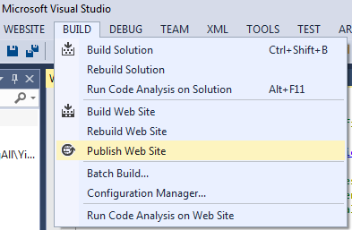
Pre-compiled Service Deployment Option
Pre-Compile and Deploy Compiled Code. In VS,
Choose “Build → Publish Web Site”,
which will create a new folder of files.
Copy this folder or all files into an existing folder instead of your original files, into destination:
Assignment submission: Blackboard: uncompiled, Server: Pre-compiler.
No cold-start: first request delay;
Code confidentiality;
Less depend on the server: e.g., you can use .Net 4.5, while server uses 4.0
Need to recompile and redeploy entirely, if the code is changed.

Slide 10
Access Privileges of Server Resources
A server is needed for your services to be accessed remotely over the internet;
When you create a service on your desktop, you have full permission to read and write data files or databases;
After you deploy the service to the server, you may not have the same permission;
Balance between the accessibility to the resources and the security of the server;
ASU WebStrar is an ETS managed IIS server. It does not allow you to register applications. The existing folders have been “Converted to Application”. Copy your files in to the existing folders.
If you use an unmanaged IIS server, e.g., ASU V-Lab, you can copy the folders into V-Lab, but you need to “Converted to Application”: In IIS Website, find the folder and right click the folder.

Slide 11
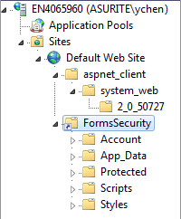
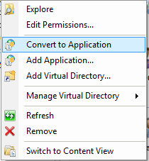
Convert to Application: Registering to WAS
Copy your application folder, e.g., FormsSecurity, into IIS wwwroot, or use a virtual directory in the wwwroot folder
Administrative Tools → IIS Manager
Find: Sites → Default Web Site
Convert to Application
Right click

Slide 12
IIS Configuration and WebStrar Deployment Tutorials for Assignment 3
In Assignment 3, you will develop & deploy Web services and simple Web applications;
Use .Net Development Server / IIS Express Server in VS and .Net framework 4.0 or later.
Use IIS on your own Windows to exercise the steps such as “Convert to Application”. This step is not required in the assignment.
Deploy your services into the given server (WebStrar or V-Lab). You must read the tutorials that come with the assignments.

Slide 13
Service Registry and Directory
Publish your Services
Find services published by other service providers
Service brokers
Registry
Registry
Application builder
Service providers
Applications
Service

Slide 14
Different Kinds of Service Brokers
Service
Brokers
A broker
with all desired
features
OASIS Standard
ebXML Integrated Registry/Repository
Extensive
automation
OASIS Standard
UDDI Registry
Limited
automation
Ad Hoc
Registry / List
Quick start
Manual search
Small / Medium IT
Non IT (Boeing)
Government
Large IT companies
MS, IBM, SAP, HP
Small companies
www.xmethods.net
www.programmableweb.com/
apis/directory/

Slide 15
Desired Features from SOC Point of View
Service registry (directory)
Service repository
Service requirement and specification
Application Templates
GUI Templates
Collaboration protocols and templates
Database and ontology
Integrated testing tools
Assurance of quality of services
Expandable and Recomposable
Current features

Slide 16
The Roles of a Service Broker
Service requesters
Service providers
Service broker
Publish requirements
Query requirements
Requirement
Applications, GUIs, services
Query application & GUI templates
Develop application/GUI templates
Application templates
Adopt and revise application & GUI template
GUI templates
Develop services
Test tools
Top down development
Publish template
Test services
Service registry
Query services
Service repository
Publish services
Build application
QoS database
Host services
Test services and application

Slide 17
UDDI Service Registry: http://www.uddi.org
Universal Description, Discovery, and Integration (UDDI) was initiated by Microsoft, IBM, and, Ariba in 2000. Hundreds of companies participated in later, including HP, Intel, Novell, Oracle, and SAP.
UDDI registry information is roughly (for nontechnical persons) organized in 3 groups:
White Pages: Contact information
Yellow Pages: Service type information
Green Pages: References to the technical information the service implements. The information can be searched and interpreted by computer programs.

Slide 18
UDDI Data Models / Data Structures
UDDI includes XML Schemas that describe five data structures.
These data structures are used for storing the Web services published in the UDDI registry:
businessEntity
businessService
bindingTemplate
tModel
publisherAssertion
White Pages
Yellow Pages
Green Pages
Green Pages
Association among UUDI pages
Next: UDDI Schema: Syntax Definition

Slide 19
What is a schema?
Database schema refers to the structure of data of how data are organized into its tables.
An XML schema is similar to DB schema. Instead of a table, it defines the structure of the XML tree.
r
id | title | publisher | price
i
t
p
p
id | title | publisher | price
0001 | SOC | KH | 90.99
0002 | OS | Pearson | 84.87
003 | Java | PH | 32.57
To be discussed in Chapter 4

Slide 20
(1) “businessEntity” Data Structure
The “businessEntity” data structure contains information about the company itself (service provider), including
Universally Unique Identifiers (UUIDs) of the company, which is assigned when the company registers at the UDDI registry;
Company Web address
Contact information;
industry categories;
a list of services provided.
White Pages

Slide 21
“businessEntity” Syntax Definition in XMLS
XML Schema (XMLS) is language used to define the syntax of other languages and data structures
<element name="businessEntity" type="uddi:businessEntity" />
<complexType name="businessEntity">
<attribute name="businessKey" type="uddi:businessKey" use="required" />
<attribute name="operator" type="string" use="optional" />
<attribute name="authorizedName" type="string" use="optional" />
<sequence>
<element ref="uddi:discoveryURLs" minOccurs="0" />
<element ref="uddi:name" maxOccurs="unbounded" />
<element ref="uddi:description" minOccurs="0" maxOccurs="unbounded" />
<element ref="uddi:contacts" minOccurs="0" />
<element ref="uddi:businessServices" minOccurs="0" />
<element ref="uddi:identifierBag" minOccurs="0" />
<element ref="uddi:categoryBag" minOccurs="0" />
</sequence>
</complexType>
Schema

Slide 22
“businessEntity”: Example (Instance)
<businessEntity
businessKey="uuid:B1D2A3B4-E445-4F32-75BA-67D123451C39"
operator=" http://www.public.asu.edu/~ychen10/teaching/cse445/"
authorizedName=“Course Instructor">
<name>ASU CSE 445-598</name>
<description> We provide sample services for SOC education </description>
<contacts>
<contact useType="general information">
<description>Email</description>
<personName> Course Instructor</personName>
<phone>(480) 965 2769</phone>
<email>cse445598instructor@asu.edu</email>
</contact>
<contact useType=" assignments and projects ">
<description>Email</description>
<personName> Teaching Assistant</personName>
<email>cse445598TA@asu.edu</email>
</contact>
</contacts>
<businessServices> Education </businessServices>
…
…
Contact1
Instance
Contact 2

Slide 23
“businessEntity”: Example (contd.)
<businessEntity businessKey="uuid:B1D2A3B4-E445-4F32-75BA-67D123451C39"
…
…
</contacts>
<businessServices>
SOC Education, SOC software development, and SOC research
</businessServices>
<identifierBag>
<keyedReference tModelKey=“uddi:02016094-9c03-47e9-a52b-1dec2d0c1454"
name="D-U-N-S" value=" 913360445 " />
</identifierBag>
<categoryBag>
<keyedReference tModelKey="UUID:C0B9FE13-179F-413D-8A5B-5004DB8E5BB2"
name="NAICS" value=“246359" />
</categoryBag>
</businessEntity>

Slide 24
(2) “businessService” Data Structure
The businessService data structure represents an individual Web service provided by the business entity (service provider)
Universally Unique Identifiers (UUIDs) are used in the businessKey and serviceKey attributes.
Every business entity and business service is uniquely identified in all UDDI registries through the UUID assigned by the registry when the information is first entered.
A reference is given to the bindingTemplates, which holds the technical service description information related to a given business service.

Slide 25
“businessService” Syntax Definition
<element name="businessService" type="uddi:businessService" />
<complexType name="businessService">
<attribute name="serviceKey" type="uddi:serviceKey" use="required" />
<attribute name="businessKey" type="uddi:businessKey" use="optional" />
<sequence>
<element ref="uddi:name" minOccurs="0" maxOccurs="unbounded" />
<element ref="uddi:description" minOccurs="0" maxOccurs="unbounded" />
<element ref="uddi:bindingTemplates" minOccurs="0" />
<element ref="uddi:categoryBag" minOccurs="0" />
</sequence>
</complexType>
Schema
You can have multiple
<businessService serviceKey="uuid:C0B9FE13-179F-413D-8A5B-5004DB8E5BB2" businessKey="uuid:01F83FCE-54AC-4C39-B274-C4A390B8EE8C">
<name>Encryption</name>
<description>
A service for string encryption and description
</description>
<bindingTemplate> ... </bindingTemplate>
<categoryBag> … </categoryBag>
</businessService >
Instance

Slide 26
(3) “bindingTemplate” Data Structure
The bindingTemplate is the technical descriptions of a Web service represented by the businessService data structure.
The same Web service may have multiple binding templates. Each binding template links to an actual implementation of the Web service.
Java implementation
C# implementation in .asmx or .svc,
Workflow implementation in .xamlx (text Chapter 7)
Because a Web service may have multiple binding templates, the service may be bound to a different set of protocols or a different URL address
SOAP Binding
MIME binding (MIME: Multipurpose Internet Mail Extension)

Slide 27
“bindingTemplate” Syntax Definition
XML Schema (XMLS) is a language used to define the syntax of other languages and data structure
<element name="bindingTemplate" type="uddi:bindingTemplate" />
<complexType name="bindingTemplate">
<attribute name="serviceKey" type="uddi:serviceKey" use="optional" />
<attribute name="bindingKey" type="uddi:bindingKey" use="required" />
<sequence>
<element ref="uddi:description" minOccurs="0" maxOccurs="unbounded" />
<choice>
<element ref="uddi:accessPoint" />
<element ref="uddi:hostingRedirector" />
</choice>
<element ref="uddi:tModelInstanceDetails" />
</sequence>
</complexType>
Schema

Slide 28
“bindingTemplate” Example
<bindingTemplate serviceKey="uuid:c1acf26d-9672-4404-9d70-39b756e62ab4" bindingKey="uuid:67153d5b-3659-afb4-8510-adda2c034649">
<description>SOAP Binding</description>
<accessPoint URLType="http">
http://venus.eas.asu.edu/WSRepository/Services/EncryptionWcf/Service.svc
</accessPoint>
<tModelInstanceDetails>
<tModelInstanceInfo tModelKey="uddi:02016094-9c03-47e9-a52b-1dec2d0c1454">
<instanceDetails>
<overviewDoc>
<description>
references the description of the WSDL service definition
</description>
<overviewURL> http://venus.eas.asu.edu/WSRepository/Services/Encryption/Service.asmx.wsdl
</overviewURL>
</overviewDoc>
</instanceDetails>
</tModelInstanceInfo>
</tModelInstanceDetails>
</bindingTemplate>
Executable of the service
Instance

Slide 29
(4) “tModel” Data Structure
A tModel is a technical way (specification) of describing the type of any business, service, template structures, etc., stored within the UDDI registry.
Any abstract concept can be registered within UDDI as a tModel.
Each business registered with UDDI categorizes and all of its services according to a defined list of service types (tModels);
When registering , you can choose to belong to an existing tModel type, and thus, compliant to the specification, or define a new tModel.
For Example, if you define a new WSDL interface, you can define a tModel that represents that interface within UDDI. Then, you can specify that a given Web service implements that interface specification by associating the tModel with one of that business service's binding templates.

Slide 30
“tModel” Syntax Definition in XML Schema
For each item registered with UDDI, a tModel key will be assigned, which associate this item with other existing items.
<element name="tModel" type="uddi:tModel" />
<complexType name="tModel">
<attribute name="tModelKey" type="uddi:tModelKey" use="required" />
<attribute name="operator" type="string" use="optional" />
<attribute name="authorizedName" type="string" use="optional" />
<sequence>
<element ref="uddi:name" />
<element ref="uddi:description" minOccurs="0" maxOccurs="unbounded" />
<element ref="uddi:overviewDoc" minOccurs="0" />
<element ref="uddi:identifierBag" minOccurs="0" />
<element ref="uddi:categoryBag" minOccurs="0" />
</sequence>
</complexType>
Schema

Slide 31
“tModel” Data Structure: Example
<tModel tModelKey="uddi:02016094-9c03-47e9-a52b-1dec2d0c1454"
operator=" http://www.public.asu.edu/~ychen10/teaching/cse445 "
authorizedName=“Course Instructor">
<name>Encryption</name>
<description>
An interface for string encryption and description
</description>
<overviewDoc>
<overviewURL>
http://venus.eas.asu.edu/WSRepository/Services/Encryption/Service.asmx.wsdl
</overviewURL>
</overviewDoc>
</tModel>
Instance

Slide 32
(5) “publisherAssertion” Data Structure
Large businesses and enterprises are not sufficiently represented by a single businessEntity.
Several businessEntity structures can be published, representing individual departments or subsidiaries.
publisherAssertion helps them to make their relationships visible in their UDDI registrations.
To eliminate the possibility that one publisher falsely claims a relationship with another, both publishers have to publish exactly the same information, in order for the relationship becoming visible.
The publisherAssertion structure consists of the three elements: fromKey (the first businessKey), toKey (the second businessKey) and keyedReference, which designates the asserted relationship type in terms of a (keyName keyValue) pair within a tModel, uniquely referenced by a tModelKey.

Slide 33
“publisherAssertion” Syntax Definition
<element name="publisherAssertion" type="uddi:publisherAssertion" />
<complexType name="publisherAssertion">
<sequence>
<element ref="uddi:fromKey" />
<element ref="uddi:toKey" />
<element ref="uddi:keyedReference" />
</sequence>
</complexType>
Schema

Slide 34
Operations (APIs) Supported by UDDI
Inquiry Operations:
Find
find_business
find_service
find_binding
find_tModel
Get details
get_businessDetail
get_serviceDetail
get_bindingDetail
get_tModelDetail
get_registeredInfo

Slide 35
Operations Supported by UDDI (contd.)
Publishing Operations:
Save
save_business
save_service
save_binding
save_tModel
Delete
delete_business
delete_service
delete_binding
delete_tModel
get_registeredInfo
Security operations:
get_authToken
discard_authToken

Slide 36
API: find_business
The find_business function searches for businesses that match the specified criteria.
Syntax
<find_business generic="2.0" [maxRows="nn"] xmlns="urn:uddi-org:api_v2">
[<findQualifiers/>]
[<name/> [<name/>] ... ]
[<discoveryURLs/>]
[<identifierBag/>]
[<categoryBag/>]
[<tModelBag/>]
</find_business>

Slide 37
API: find_business Arguments
maxRows Optional attribute to specify the maximum number of rows to be returned;
findQualifiers Optional element to override the default search functionality. For example, the find qualifier exactNameMatch will match exact business names.
name: The full or partial name of the business. UDDI 2.0 enables you to specify up to five business names.
discoveryURLs: Optional element to search by discovery URLs.
identifierBag: Optional element to search by identifier.
categoryBag: Optional element to search by category. For example, you can search by NAICS codes.
tModelBag: Optional element to search by tModel records.

Slide 38
Microsoft Enterprise UDDI Services It is a part of the Windows Server
Web browser clients
(human users)
Web services clients
(program users)
Manual
HTTP protocol
Automatic
ASP .Net Pages
Web service interfaces
UDDI request management
Database Web server IIS
UDDI class library
MSDE/SQL Server

Slide 39
Search and Discover a Service
A service requester
Service broker
Find a
Service:
“find_service”
HTTP server
SOAP server
Functional request
SOAP request
Service match and discovery
HTTP request
WSDL Interface
Taxonomy
Service
registry
Ontology
HTTP response
Why an ontology, instead of a database?
An ontology allows semantics-based search and reasoning

Slide 40
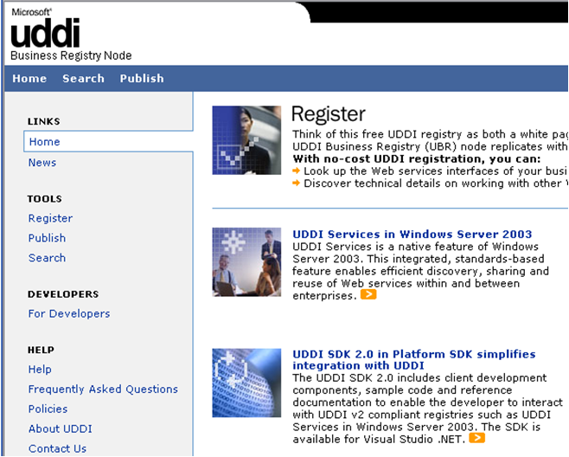
UDDI Services
1. Create a new account
2. Publish your services
3. Search for services

Slide 41
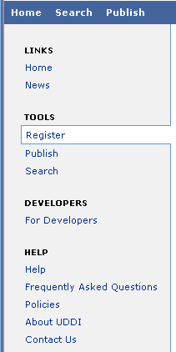
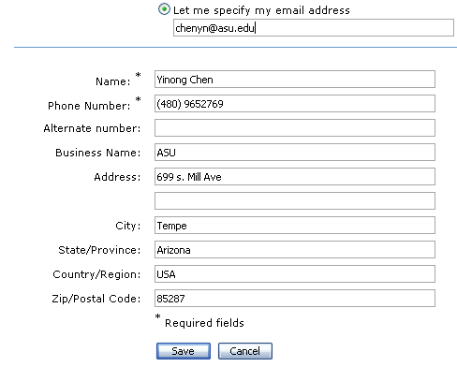
Register a new account: A manual process

Slide 42
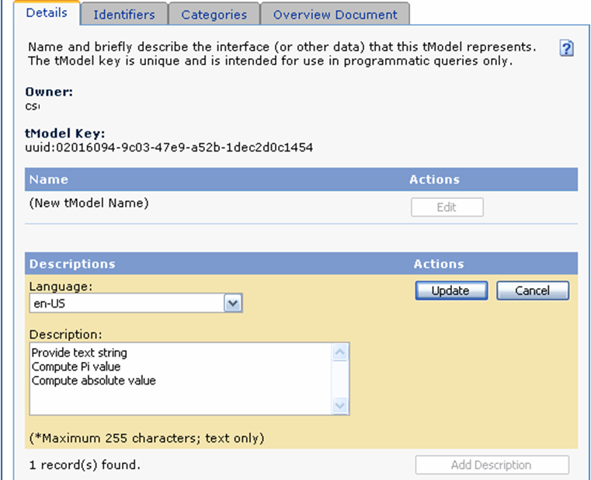
Publish a Service

Slide 43
Service Broker (Continued)
Service brokers
Registry
Repository
Hosting
Application builder
Service providers
Application
Service
Hosting

Slide 44
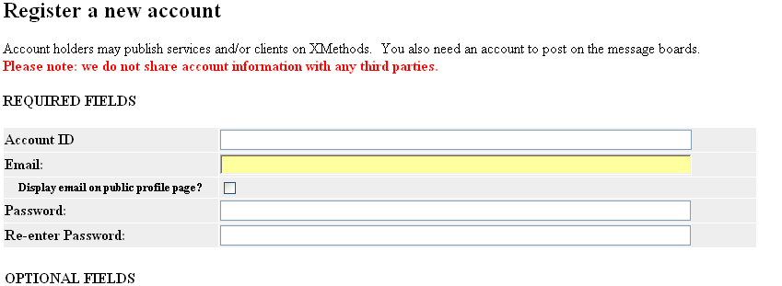
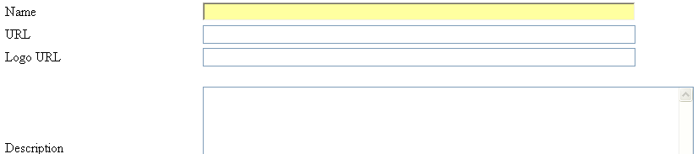
Register as a service Provider at www.Xmethods.net
One can implement the registration service to allow other people to submit services, and then automatically list the service in the directory.

Slide 45
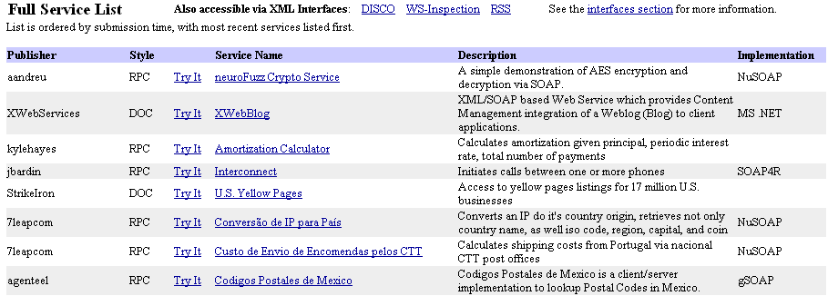

Services Available at www.Xmethods.net

Slide 46
National Database Services
National Digital Forecast Database (NDFD) Simple Object Access Protocol (SOAP) Web Services: http://graphical.weather.gov/xml/
Weather services based on latitude and longitude locations
WSDL/SOAP Services
RESTful Services
National Geophysical Data Center Web Services: http://www.ngdc.noaa.gov/dmsp/maps.html
Online Maps and Web Services

Slide 47
Amazon Web Services
AWS Catalog:
http://developer.amazonwebservices.com/
http://solutions.amazonwebservices.com/connect/index.jspa
The following link gives a tutorial on using AWS http://channel9.msdn.com/coding4fun/articles/Using-the-Amazon-Web-Service
Another one:
http://www.odetocode.com/Articles/158.aspx
Find more tutorials

Slide 48
Amazon Web Services http://solutions.amazonwebservices.com/connect/index.jspa
Registration is required to use these services, but some services are free, yet
Solutions for
Amazon Associates
Developers
Businesses
Amazon Sellers
Consumers
Browse by Services
Amazon E-Commerce Service
Amazon Elastic Compute Cloud
Amazon Historical Pricing
Amazon Mechanical Turk (Beta)
Amazon Simple Queue Service
Amazon Simple Storage Service
Alexa Site Thumbnail
Alexa Top Sites
Alexa Web Information Service
Alexa Web Search

Slide 49
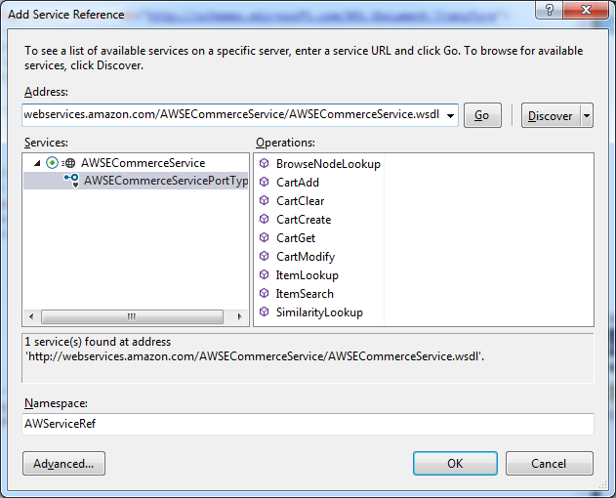
Adding Web Services
http://webservices.amazon.com/AWSECommerceService/AWSECommerceService.wsdl

Slide 50
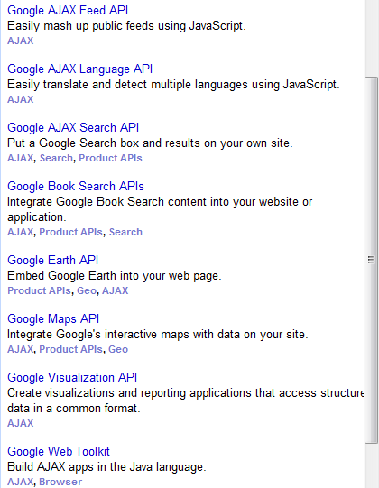
Google Service (Mostly, RESTful Services)
Google Web APIs http://code.google.com/
http://code.google.com/more/
Google Web API Forum http://groups.google.com/group/google.public.web-apis
Google Web API FAQ http://www.google.com/apis/api_faq.html#gen6

Slide 51
Microsoft Services: http://msdn.microsoft.com/en-us/library/
Bing SOAP Services: http://msdn.microsoft.com/en-us/library/cc966738.aspx
Service Name | Production Service Metadata URL
Geocode Service | http://dev.virtualearth.net/webservices/v1/geocodeservice/geocodeservice.svc
Imagery Service | http://dev.virtualearth.net/webservices/v1/imageryservice/imageryservice.svc
Route Service | http://dev.virtualearth.net/webservices/v1/routeservice/routeservice.svc
Search Service | http://dev.virtualearth.net/webservices/v1/searchservice/searchservice.svc
Bing RESTful Services: http://msdn.microsoft.com/en-us/library/ff701713.aspx
Bing APIs: http://msdn.microsoft.com/en-us/library/ff701722.aspx
Locations API | Use the Locations API to geocode and reverse-geocode location data.
Imagery API | Use the Imagery API to get a static map and imagery data information such as map tiles and providers.
Routes API | Use the Routes API to get directions and route information for driving, walking or using transit.
Traffic API | Use the Traffic API to get information about traffic incidents and issues in a specified area.
Common Parameters and Types | Use common parameters and types to specify values such as culture and pushpin styles.
Common Response Description | Use this description to understand the results returned for a Bing Maps REST Services request.
Status Codes and Errors | Use the status and error code descriptions for troubleshooting.

Slide 52
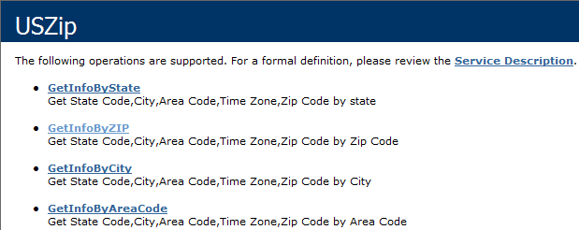
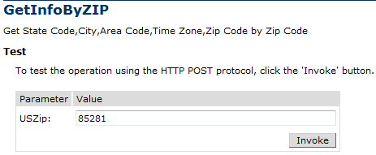
Services from: http://www.webservicex.net/
Test the service at: http://www.webservicex.net/uszip.asmx
WSDL File
Try It
A DataSet can be accessed as an XML file, or as table (2D-array) through indices.
<?xml version="1.0" encoding="utf-8" ?>
<NewDataSet>
<Table>
<CITY>Tempe</CITY>
<STATE>AZ</STATE>
<ZIP>85281</ZIP>
<AREA_CODE>602</AREA_CODE>
<TIME_ZONE>M</TIME_ZONE>
</Table>
</NewDataSet>

Slide 53
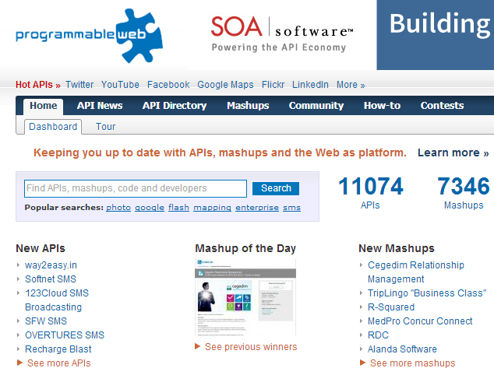
Services from: http://www.programmableweb.com/
API Directory: http://www.programmableweb.com/apis/directory

Slide 54
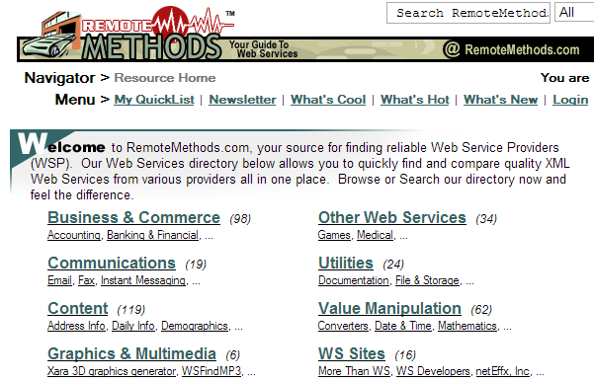
Services from: http://www.remotemethods.com/

Slide 55
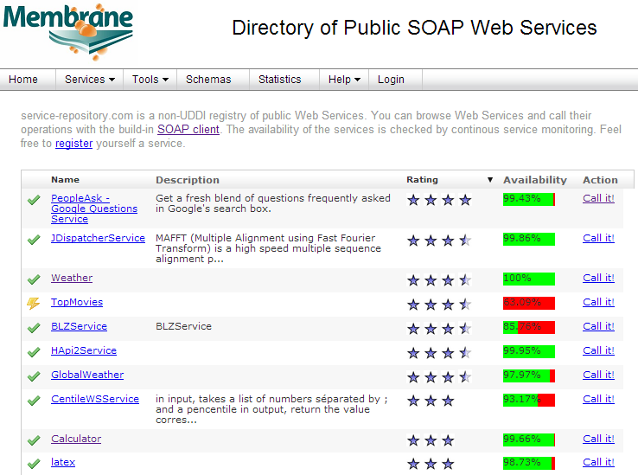
Membrane: http://www.service-repository.com/
More services: http://www.service-repository.com/endpoint/hosts

Slide 56
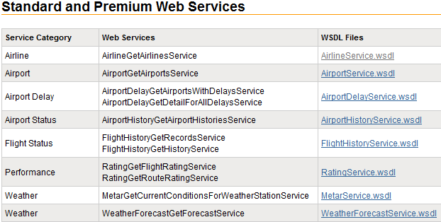
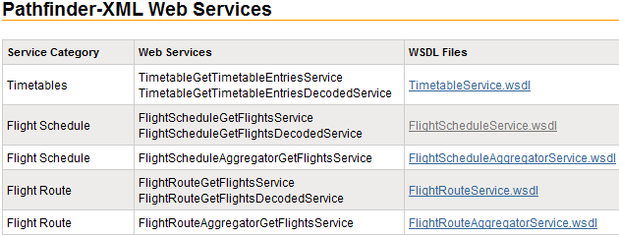
FlightStats: https://www.flightstats.com/developers/bin/view/Web+Services/WSDL

Slide 57
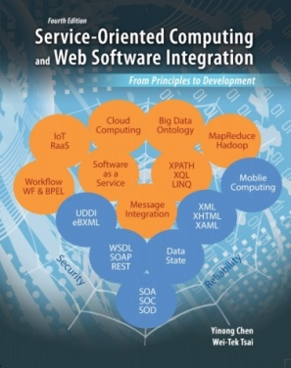
Web Services Search Engines
ASU Repository of Services and Applications (http://venus.eas.asu.edu/WSRepository/repository.html)
CSE445/598 Textbook, Appendix C
ASU Services Search Engine (http://venus.eas.asu.edu/sse/)
A directory of services
Using a crawler to discover services and store the directory information into a database
Seekda (http://webservices.seekda.com/)
A Web Services portal that provides a direct access to a robust technology platform enabling search for public Web Services
A catalogue of more than 28,000 service descriptions
http://www.serviceplatform.org/: Open Source Service Platform Research
http://data.serviceplatform.org/servicefinder/

